Slide 1
Problem Solving by Searching
Unit 3

Slide 2
Introduction
Problem solving in AI is a systematic search through a range of possible action in order to reach some predefined goal or solutions.
There are four general states in problem solving which are as follows:
Goal formulation: A goal is a agent that the agent is trying to reach.
Problem formulation: This is the process of deciding what actions and states and goal to consider.
Search method: it determines possible sequence of actions and choose the best one.
Execute: it provides the solution to perform action.

Slide 3
Searching :It is commonly used method in AI for solving problems.
The search technique explores the possible moves that one can make in a space of ‘states’ called the search space.
In Artificial Intelligence, a search technique is used to explore all possible configurations or states of a problem to find a solution. These states form a structure known as the search space.

Slide 4
Problem formulation: In AI, it is the process of defining a problem in a way that a computer can understand and solve it using AI techniques—especially search algorithms.
Component of problem formulation:
Initial State: The starting point of the problem.
State Space: All possible states reachable from the initial state.
Actions: Legal moves or operations that can be performed.
Transition Model: Describes what results from performing an action in a state.
Goal Test: Checks whether a given state is a goal state.
Path Cost: (Optional) A numeric cost for a path, used in optimization.

Slide 5
State Space Representation
**see in copy**

Slide 7
Well defined Problems
A problems that lacks one or more of the below 5 properties is an ill-defined problem.
But a well-defined problem can be defined formally by following five components:
Initial state: state from which agent start.
State description ( Success or function): description of possible actions available on agent.
State space and path: all states reachable from initial by any sequence of actions is state space. Path is the sequence through state space.
Path cost: sum of cost of each path from initial to given state.
Goal test: determining the state is goal state or not.

Slide 8
Well defined problem:
Vaccum world state problem
Real world problem( used to define the time, money and human resource cost)
Toy problem (used to compare performance of system)

Slide 9
Solving Problems by searching
Figure bellow contains representation of a map. The nodes represent cities, and the links represent direct road connections between cities. The number associated to a link represent the length of the corresponding road. The search problem is to find a path from a city S to a city G.

Slide 10
FIG: graph representation of map
6
D
A
2
4
G
S
3
F
B
E
4
3
5

Slide 11
This problem will be used to illustrate some search methods.
Search problems are part of a large number of real world applications
VLSI layout
Web Search
Path Planning
Robot navigation etc

Slide 12
Search techniques / search strategies
There are two broad search strategies:
Uniformed ( or blind) search methods: In the method, the order in which potential solution path is considered in arbitrary, using-no domain specific information to judge where the solution is likely to lie. Eg Breadth first search, Depth first Search, Depth limit search, Bidirectional Search etc.
Heuristically informed search methods: In this method, one uses domain-dependent ( heuristic ) information in order to search the space more efficiently. Eg: Greedy best first search, A* search, Hill climbing search etc.

Slide 13
Performance evaluation of search technique
We can evaluate the performance of search techniques in four ways:
Completeness: An algorithm is said to be complete if it definitely finds solution to the problem, if exist.
Time complexity: how long ( worst or average case) does it take to find a solution? Usually in terms of number of nodes expanded.
Space complexity: how much space is used by the algorithm? usually measured in terms of the maximum number of nodes in memory at a time.
Optimality/ admissibility: If a solution is found, is it guaranteed to be optimal one? For example is it the one with minimum cost?
time and space complexity are measured in terms of:
b =minimum branching factor (number of successor of any node) of the search tree.
m= depth of the least-cost solution
d= maximum length of any path in the space.

Slide 14
Uniform Cost Search
It is uninformed search algorithm.
Finds the least-cost path from a start node to a goal node in a weighted graph.
Variant of Dijkastra algorithm.
Guarantees optimal solution if step costs are non-negative.
Explores nodes with the lowest cumulative cost first.
Uses a priority queue to manage nodes.

Slide 15
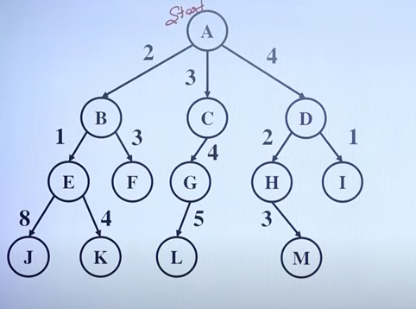
Consider the following graph. Let the starting node be A and the goal node be M.

Slide 16
Heuristic Function
Heuristic function h(n) estimates the goodness of a node n.
It is estimate based on domain-specific information that is computable from current state description of how close we are to goal.
h(n) = estimated cost (distance ) of minimal cost path from n to goal state.

Slide 17
Informed or heuristic search
Best-First Search:
In this search we use evaluation function f(n) that determines which node is to expand next, that means node with lowest f(n) is expanded first.
The major source of information for f(n) is h(n).
This strategy use estimates of the cost reaching the goal and try to minimize it.
It consists of two types based on the evaluation function with special cases which are as follows:

Slide 18
Greedy best-first search
This method uses evaluation function to select which node to be expanded next.
The node with lowest evaluation is selected for expansion because it has the closest path to goal.
Evaluation function f(n)=h(n)
Estimate of cost from n to goal.
This algorithm has O(b^{m}) space and time complexity, where b is the average branching factor and m is the maximum depth of the search tree.

Slide 19
example
8
9
E
B
S
7
9
8
5
C
6
D
G
10

Slide 20
Let G be the goal node, then distance to node G from other node are:
S->G =12
B->G=4
E->G=7
D->G =5
C->G=3
now, greedy search operation is done as bellow:

Slide 21
Step 1
Step 3
Step 2
H(n)=12
S
H(n)=12
H(n)=5
H(n)=12
S
S
H(n)=4
D
H(n)=4
H(n)=5
B
B
D
B
D
H(n)=7
H(n)=3
E
C
E
C
H(n)=4
H(n)=5
H(n)=7
H(n)=3
D
G
H(n)=5
H(n)=0

Slide 22
Performance measures:
Completness: it is not complete because while minimizing the value of heuristic greedy may oscillate between the two nodes
Time complexity: O(b^{m})
Space complexity : O(b^{m})
Optimality: it is not optimal.

Slide 23
A* search
Admissible heuristic:
A heuristic function is said to be admissible if it is no more then the lowest-cost path to the goal.
It is used to estimate the cost of reaching the goal state in an informed search algorithm.
The estimated cost must be always be lower then the actual cost reaching the goal state.
A* search uses heuristic function h(n) as well as the path cost to the node g(n) in computing the total cost f(n).
f(n)=h(n)+g(n), where
f(n) is evaluation function,
h(n)= estimated cost from current node to goal node,
g(n) = the cost from the start node to current node.

Slide 24
This method follows a path of the lowest known path keeping a sorted priority queue of alternate path segments along the way.
If path being traversed has higher cost than another path then it neglects the higher cost path and traverses lower cost path segment.
This process continues until goal is reached.

Slide 25
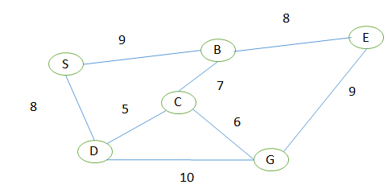
Example

Slide 26
Let G be the goal node, then distance to node G from other node are:
S->G =12
B->G=4
E->G=7
D->G =6
C->G=3

Slide 27
Step 1
Step 2: for B
S
f(n)=12
S
f(n)=12
9
8
F(B)=9+4=13
f(n)=13
B
D
9
8
F(D)=8+6=14
f(n)=14
8
7
B
D
F(E)=17+7=24
E
C
f(n)=14
f(n)=24
f(n)=19
F(C)=16+3=19
f(n)=13

Slide 28
Step 4
Step 3
f(n)=12
S
9
8
S
F(G)=17+0=18
f(n)=12
B
D
9
F(C)=13+3=16
8
B
D
f(D)=14
E
C
G
C
f(G)=16
f(n)=13
G
C
f(C)=16
E
C
G
B
f(n)=24
f(n)=19
f(n)=18
f(n)=124

Slide 29
Evaluation / performance measures:
Completeness: A* gives us solution.
Time complexity: O(b^{d})
Space complexity: it keeps all generated nodes in memory. Hence space is the major problem not time.
Optimality: A* gives optimal solution.
Admissibility: A* is admissible and considers fewer nodes than any other admissible search algorithm with the same heuristic.

Slide 30
Hill climbing search
This search technique can be used to solve problems that have many solutions, some of which are better then others.
It starts with a random solution and iteratively makes small changes to the solution, each time improving a little.
When the algorithm cannot see any improvement anymore, it terminates.

Slide 31
8.5
6
3
A
B
4
C
4
3
10
S
5
5
G
4
D
E
F
3
2
4
8
6
3

Slide 32
The hill climbing search from S to G proceeds as shown by arrow as shown bellow
S
A
D
8
8.5
A
6
E
8.5
F
3
B
6
G

Slide 33
Game playing
Game playing is an important domain of AI.
Games don’t require much knowledge, it only needs to provide is the rules.
Both players try to win the game.
So both of them try to make the best move possible at each time.
Searching techniques like BFS are not accurate for this as the branching factor is very high as minimum 35, so searching will take a lot of time.
So we need another search procedures that improves searching time.
Games are a form of multi-agent environment and arise questions like what another agent do and how they affect our success?
Competitive multi-agent environment give rise to games.

Slide 34
Adversarial Search techniques
Adversarial search is also known as Minimax search used in calculating the best move in two player games where all the information is available such as chess or tic-tac toe.
It consists of navigating through a tree which captures all the possible moves in the game, where each move is represented in terms of loss and gain for one the players.

Slide 35
Game-adversary
Solution is strategy ( strategy specifies move for every possible opponent reply)
Time limits force an appropriate solutions.
Evaluation function: evaluate “goodness” of game position
Examples: chess, checkers, backgammon

Slide 36
The mini-max serach
Let us assign the following value for the game : 1 for win by x, 0 for draw by x, -1 for loss by x.
Given the values of the terminal nodes (win for x(1), loss for x(-1), draw for x(0)), now the values of the non-terminal nodes are computed as following:
The value of a node where it is the turn of player X to move is the maximum of the values of its successor ( because x tries to maximize its outcome).
The value of a node where it is the turn of player 0 to move is the minimum of the values of its successors ( because 0 tries to minimize the outcome of X).

Slide 37
Consider the following game tree ( drawn from the point of view of the maximizing player)
max
A
min
min
B
C
max
max
D
E
F
G
O
P
R
H
I
J
K
L
M
N
9
2
3
5
3
1
1
4
7
5

Slide 38
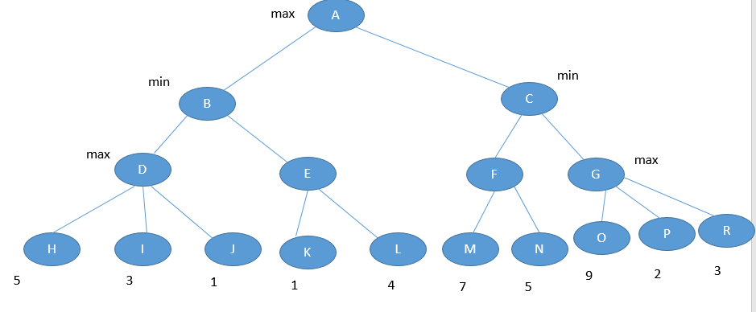
7
4
7
9
5
4
7
Min-max value=7

Slide 39
Alpha-beta pruning
This method is applied to a standard minmax tree, it returns the same more as min max would, but prunes away branches that cannot possibly influence the final decision.
Alpha-beta pruning can be applied to trees of any depth and it is often possible to prune entire sub-tree rather then just leaves.
This is a technique for evaluating nodes of a game tree that eliminates unnecessary evaluations.
It uses two parameter alpha and beta.
Alpha: it is the value of the best( i.e highest value) choice we have found so far at any choice along the path for MAX.
Beta: it is the value of the best ( i.e lowest value) choice we have found so far at any choice along the path for MIN.

Slide 40
Constraint satisfaction Problem
Consists of three components: V,D,C
V is set of variables: { v1,v2,v3…vn}
D is set of domain :

